Slide 1
Matrix Multiplication
Hung-yi Lee
Notes:
Chapter 2.2
Application of matrix multiplication

Slide 2
Reference
Textbook: Chapter 2.1

Slide 3



Matrix Multiplication
Given two matrices A and B, the (i, j)-entry of AB is the inner product of row i of A and column j of B
B
A
$$C=AB$$
$$c_{ij}$$

Slide 4


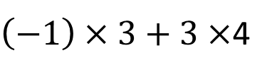


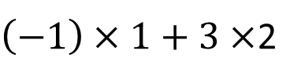


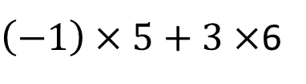
Matrix Multiplication
Given two matrices A and B, the (i, j)-entry of AB is the inner product of row i of A and column j of B
$$A=\left[\begin{matrix}1 & 2 \\ 3 & 4 \\ 5 & 6\end{matrix}\right]$$
$$B=\left[\begin{matrix}−1 & 1 \\ 3 & 2\end{matrix}\right]$$
$\left(−1\right)×1+3×$2
$$1×1+2×2$$
$$C=AB$$
=
$\left(−1\right)×3+3×$4
$$1×3+2×4$$
$\left(−1\right)×5+3×$6
$$1×5+2×6$$

Slide 5
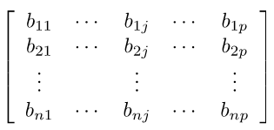
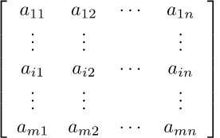
Matrix Multiplication – 4 ways
Way 1: inner product
Given two matrices A and B, the (i, j)-entry of AB is the inner product of row i of A and column j of B
B
A
(i,j)-entry
AB

Slide 6


Matrix Multiplication – 4 ways
Way 1: inner product
Given two matrices A and B, the (i, j)-entry of AB is the inner product of row i of A and column j of B
$$\left[\begin{matrix}−1 & 1 \\ 3 & 2\end{matrix}\right]$$
B
5
$$\left[\begin{matrix}1 & 2 \\ 3 & 4 \\ 5 & 6\end{matrix}\right]$$
A
AB
17

Slide 7






















Matrix Multiplication – 4 ways
Way 2: Linear combination of columns
……
……
$$a_{1}$$
$$a_{2}$$
$$a_{n}$$
$$b_{1}$$
$$b_{2}$$
$$b_{p}$$
$$+$$
…
$$+$$
…
……
$$+$$
$$+$$
=
$$b_{11}$$
$$b_{12}$$
$$b_{21}$$
$$b_{22}$$
$$b_{1n}$$
$$b_{2n}$$
$$a_{1}$$
$$a_{2}$$
$$a_{n}$$
$$a_{1}$$
$$a_{2}$$
$$a_{n}$$
The first column
The second column

Slide 8




Matrix Multiplication – 4 ways
Way 2: Linear combination of columns
$$\left[\begin{matrix}1 & 2 \\ 3 & 4 \\ 5 & 6\end{matrix}\right]$$
$$\left[\begin{matrix}−1 & 1 \\ 3 & 2\end{matrix}\right]$$
$$−1\left[\begin{matrix}1 \\ 3 \\ 5\end{matrix}\right]+3\left[\begin{matrix}2 \\ 4 \\ 6\end{matrix}\right]$$
$$1\left[\begin{matrix}1 \\ 3 \\ 5\end{matrix}\right]+2\left[\begin{matrix}2 \\ 4 \\ 6\end{matrix}\right]$$
=
The second column
The first column

Slide 9









Matrix Multiplication – 4 ways
Way 3: Linear combination of rows
$${a_{11}b}_{1}^{T}+{a_{12}b}_{2}^{T}⋯+{a_{1n}b}_{n}^{T}$$
$$a_{1}^{T}$$
$$b_{1}^{T}$$
$${a_{21}b}_{1}^{T}+{a_{22}b}_{2}^{T}⋯+{a_{2n}b}_{n}^{T}$$
$$a_{2}^{T}$$
$$b_{2}^{T}$$
……
……
=
……
$$a_{m}^{T}$$
$$b_{n}^{T}$$
$${a_{m1}b}_{1}^{T}+{a_{m2}b}_{2}^{T}⋯+{a_{mn}b}_{n}^{T}$$

Slide 10





Matrix Multiplication – 4 ways
Way 3: Linear combination of rows
$$1\left[\begin{matrix}−1 & 1\end{matrix}\right]+2\left[\begin{matrix}3 & 2\end{matrix}\right]$$
The first row
$$\left[\begin{matrix}1 & 2 \\ 3 & 4 \\ 5 & 6\end{matrix}\right]$$
$$\left[\begin{matrix}−1 & 1 \\ 3 & 2\end{matrix}\right]$$
$$3\left[\begin{matrix}−1 & 1\end{matrix}\right]+4\left[\begin{matrix}3 & 2\end{matrix}\right]$$
=
The second row
$$5\left[\begin{matrix}−1 & 1\end{matrix}\right]+6\left[\begin{matrix}3 & 2\end{matrix}\right]$$
The third row

Slide 11









Matrix Multiplication – 4 ways
Way 4: summation of matrices
$$b_{1}^{T}$$
$$b_{2}^{T}$$
……
$$b_{3}^{T}$$
……
$$a_{1}$$
$$a_{2}$$
$$a_{3}$$
$$a_{n}$$
$$b_{n}^{T}$$
$$=a_{1}b_{1}^{T}+a_{2}b_{2}^{T}+⋯+a_{n}b_{n}^{T}$$
matrices

Slide 12








Matrix Multiplication – 4 ways
Way 4: summation of matrices
$$\left[\begin{matrix}1 & 2 \\ 3 & 4 \\ 5 & 6\end{matrix}\right]$$
$$\left[\begin{matrix}1 \\ 3 \\ 5\end{matrix}\right]\left[\begin{matrix}−1 & 1\end{matrix}\right]$$
$$\left[\begin{matrix}2 \\ 4 \\ 6\end{matrix}\right]\left[\begin{matrix}3 & 2\end{matrix}\right]$$
$$\left[\begin{matrix}−1 & 1 \\ 3 & 2\end{matrix}\right]$$
=
$$+$$
“2 x 1”
“1 x 2”
“1 x 1”
$$\left[\begin{matrix}−1 & 1 \\ −3 & 3 \\ −5 & 5\end{matrix} \right]$$
$$\left[\begin{matrix}6 & 4 \\ 12 & 8 \\ 18 & 12\end{matrix} \right]$$
=
$$+$$
Rank = ?
Rank = ?

Slide 13




Augmentation and Partition
Augment: the augment of A and B is [A B]
Partition:
$$A=\left[\begin{matrix}\begin{matrix}1 & 2\end{matrix} & \begin{matrix}3 & 4\end{matrix} \\ \begin{matrix}5 & 6\end{matrix} & \begin{matrix}7 & 8\end{matrix} \\ \begin{matrix}4 & 3\end{matrix} & \begin{matrix}2 & 1\end{matrix}\end{matrix}\right]$$
$$A=\left[\begin{matrix}\begin{matrix}1 & 2\end{matrix} & \begin{matrix}3 & 4\end{matrix} \\ \begin{matrix}5 & 6\end{matrix} & \begin{matrix}7 & 8\end{matrix} \\ \begin{matrix}4 & 3\end{matrix} & \begin{matrix}2 & 1\end{matrix}\end{matrix}\right]$$
$$A=\left[\begin{matrix}\begin{matrix}1 & 2\end{matrix} & \begin{matrix}3 & 4\end{matrix} \\ \begin{matrix}5 & 6\end{matrix} & \begin{matrix}7 & 8\end{matrix} \\ \begin{matrix}4 & 3\end{matrix} & \begin{matrix}2 & 1\end{matrix}\end{matrix}\right]$$
$$A=\left[\begin{matrix}\begin{matrix}1 & 2\end{matrix} & \begin{matrix}3 & 4\end{matrix} \\ \begin{matrix}5 & 6\end{matrix} & \begin{matrix}7 & 8\end{matrix} \\ \begin{matrix}4 & 3\end{matrix} & \begin{matrix}2 & 1\end{matrix}\end{matrix}\right]$$

Slide 14

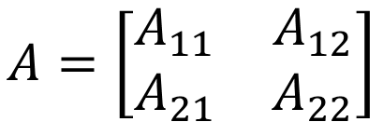
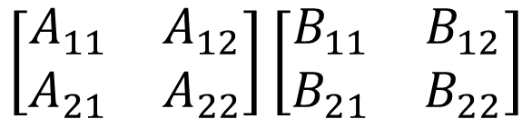

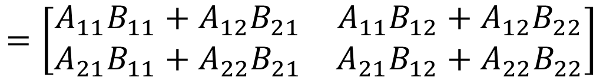
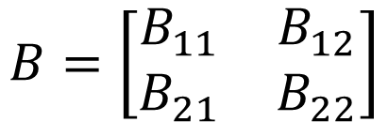

Block Multiplication
$$B=\left[\begin{matrix}\begin{matrix}1 \\ 1\end{matrix} & \begin{matrix}0 \\ 2\end{matrix} & \begin{matrix}3 \\ 0\end{matrix} \\ \begin{matrix}2 \\ 0\end{matrix} & \begin{matrix}−1 \\ 3\end{matrix} & \begin{matrix}2 \\ 1\end{matrix}\end{matrix}\right]$$
$$A=\left[\begin{matrix}\begin{matrix}1 & 3\end{matrix} & \begin{matrix}4 & 2\end{matrix} \\ \begin{matrix}0 & 5\end{matrix} & \begin{matrix}−1 & 6\end{matrix} \\ \begin{matrix}1 & 0\end{matrix} & \begin{matrix}3 & −1\end{matrix}\end{matrix}\right]$$
$$A=\left[\begin{matrix}A_{11} & A_{12} \\ A_{21} & A_{22}\end{matrix}\right]$$
$$B=\left[\begin{matrix}B_{11} & B_{12} \\ B_{21} & B_{22}\end{matrix}\right]$$
$$\left[\begin{matrix}A_{11} & A_{12} \\ A_{21} & A_{22}\end{matrix}\right]\left[\begin{matrix}B_{11} & B_{12} \\ B_{21} & B_{22}\end{matrix}\right]$$
Multiply as the small matrices are scalar
$$AB=$$
$$=\left[\begin{matrix}A_{11}B_{11}+A_{12}B_{21} & A_{11}B_{12}+A_{12}B_{22} \\ A_{21}B_{11}+A_{22}B_{21} & A_{21}B_{12}+A_{22}B_{22}\end{matrix}\right]$$
Don’t switch the order
Notes:
Check the example in P92

Slide 15





Block Multiplication
$$B=\left[\begin{matrix}\begin{matrix}1 \\ 1\end{matrix} & \begin{matrix}0 \\ 2\end{matrix} & \begin{matrix}3 \\ 0\end{matrix} \\ \begin{matrix}2 \\ 0\end{matrix} & \begin{matrix}−1 \\ 3\end{matrix} & \begin{matrix}2 \\ 1\end{matrix}\end{matrix}\right]$$
$$A=\left[\begin{matrix}\begin{matrix}1 & 3\end{matrix} & \begin{matrix}4 & 2\end{matrix} \\ \begin{matrix}0 & 5\end{matrix} & \begin{matrix}−1 & 6\end{matrix} \\ \begin{matrix}1 & 0\end{matrix} & \begin{matrix}3 & −1\end{matrix}\end{matrix}\right]$$
“2 x 2”
“2 x 2”
$$+$$
$$+$$
$$AB=$$
2 X 2
2 X 1
“2 x 2”
$$+$$
$$+$$
1 X 2
1 X 1
Notes:
Check the example in P92

Slide 16
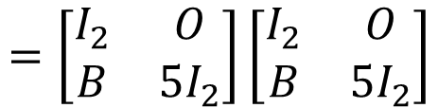
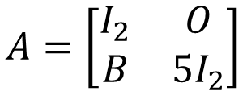

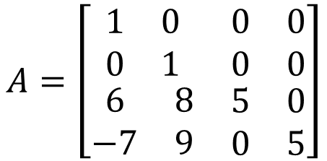

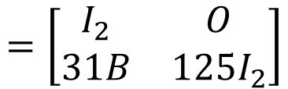

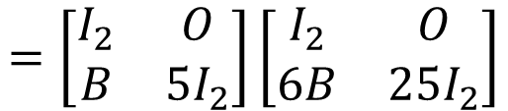
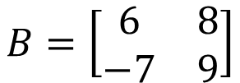
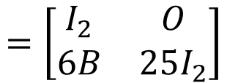
Block Multiplication
$$A=\left[\begin{matrix}\begin{matrix}1 & 0 \\ 0 & 1\end{matrix} & \begin{matrix}0 & 0 \\ 0 & 0\end{matrix} \\ \begin{matrix}6 & 8 \\ −7 & 9\end{matrix} & \begin{matrix}5 & 0 \\ 0 & 5\end{matrix}\end{matrix}\right]$$
$$A=\left[\begin{matrix}I_{2} & O \\ B & 5I_{2}\end{matrix}\right]$$
$$B=\left[\begin{matrix}6 & 8 \\ −7 & 9\end{matrix}\right]$$
$$=\left[\begin{matrix}I_{2} & O \\ B & 5I_{2}\end{matrix}\right]\left[\begin{matrix}I_{2} & O \\ B & 5I_{2}\end{matrix}\right]$$
$$=\left[\begin{matrix}I_{2} & O \\ 6B & 25I_{2}\end{matrix}\right]$$
$$A^{2}$$
$$=\left[\begin{matrix}I_{2} & O \\ B & 5I_{2}\end{matrix}\right]\left[\begin{matrix}I_{2} & O \\ 6B & 25I_{2}\end{matrix}\right]$$
$$=\left[\begin{matrix}I_{2} & O \\ 31B & 125I_{2}\end{matrix}\right]$$
$$A^{3}$$
$${=AA}^{2}$$

Slide 17



Matrix Multiplication - Meaning
Multiple Input
$$C=AB$$
A
b₁
c₁
A
b₁
b₂
b_{p}
=
…
A
b₂
c₂
=
c₁
c₂
c_{p}
=
…
……
A
b_{p}
c_{p}
$$AB=A\left[\begin{matrix}\begin{matrix}b_{1} & b_{2}\end{matrix} & \begin{matrix}⋯ & b_{p}\end{matrix}\end{matrix}\right]$$
=
$$=\left[A\begin{matrix}\begin{matrix}b_{1} & Ab_{2}\end{matrix} & \begin{matrix}⋯ & Ab_{p}\end{matrix}\end{matrix}\right]$$
Notes:
A set of matrix-vector product

Slide 18






Matrix Multiplication - Meaning
Composition
Given two function $f$ and $g$, the function $g\left(f\left(.\right)\right)$ is the composition $g°f.$
g
f
$$y=g\left(v\right)$$
$$v=f\left(x\right)$$
$$x$$
g ◦ f
$$y=g\left(f\left(x\right)\right)$$
$$x$$
Matrix multiplication is the composition of two linear functions.

Slide 19










Matrix Multiplication - Meaning
Composition
$$m×n$$
$$n×p$$
A
B
$$y$$
$$v$$
$$x$$
$$y=Av$$
$$v=Bx$$
C
$$y$$
$$x$$
$$m×p$$

Slide 20

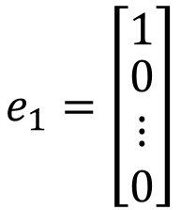


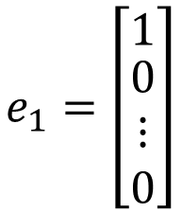
Matrix Multiplication - Meaning
The first column of B
$$e_{1}=\left[\begin{matrix}1 \\ \begin{matrix}0 \\ ⋮ \\ 0\end{matrix}\end{matrix}\right]$$
$$m×n$$
$$n×p$$
A
B
$${Ab}_{1}$$
$$b_{1}$$
$$y=Av$$
$$v=Bx$$
C
$$e_{1}=\left[\begin{matrix}1 \\ \begin{matrix}0 \\ ⋮ \\ 0\end{matrix}\end{matrix}\right]$$
Input standard matrix
The first column of C
$$c_{1}$$
$$m×p$$

Slide 21





Matrix Multiplication - Meaning
The second column of B
$$e_{2}=\left[\begin{matrix}0 \\ \begin{matrix}1 \\ ⋮ \\ 0\end{matrix}\end{matrix}\right]$$
$$m×n$$
$$n×p$$
A
B
$${Ab}_{2}$$
$$b_{2}$$
$$y=Av$$
$$v=Bx$$
C
$$e_{2}=\left[\begin{matrix}0 \\ \begin{matrix}1 \\ ⋮ \\ 0\end{matrix}\end{matrix}\right]$$
Input standard matrix
The second column of C
$$c_{2}$$
$$m×p$$

Slide 22








A
B
$$y$$
$$v$$
$$x$$
$$y=Av$$
$$v=Bx$$
C
$$y$$
$$C=AB$$
$$x$$
The composition of A and B is
$$C=\left[\begin{matrix}\begin{matrix}{Ab}_{1} & {Ab}_{2} \end{matrix} & \begin{matrix}⋯ & Ab_{p} \end{matrix}\end{matrix}\right]=AB$$
Matrix Multiplication

Slide 23













Example
$$\left[\begin{matrix}1 & 0 \\ 0 & −1\end{matrix}\right]$$
$$\left[\begin{matrix}−1 & 0 \\ 0 & −1\end{matrix}\right]$$
$$=\left[\begin{matrix}−1 & 0 \\ 0 & 1\end{matrix}\right]$$
reflection about the x-axis
rotation by 180□
R²
R²
R²
$$y$$
$$\left[\begin{matrix}1 & 0 \\ 0 & −1\end{matrix}\right]$$
$$v$$
$$\left[\begin{matrix}−1 & 0 \\ 0 & −1\end{matrix}\right]$$
$$x$$
$$y=Av$$
$$v=Bx$$
$$y$$
$$\left[\begin{matrix}−1 & 0 \\ 0 & 1\end{matrix}\right]$$
$$x$$
reflection about the y-axis

Slide 24

Not Communicative
$AB≠BA$
Notes:
可以舉個例子嗎

Slide 25










Not Communicative
$$m×n$$
$$n×p$$
A
B
$$y$$
$$v$$
$$x$$
B
A
$$y′$$
$$v′$$
$$x$$
接不起來 …
$$n×p$$
$$m×n$$
If A and B are matrices, then both AB and BA are defined if and only if A and B are square matrices?

Slide 26
Properties
Let A and B be k x m matrices, C be an m x n matrix, and P and Q be n x p matrices
For any scalar s, s(AC) = (sA)C = A(sC)
(A + B)C = AC + BC
C(P+Q)=CP+CQ
I_{k}A = A = AI_{m}
The product of any matrix and a zero matrix is a zero matrix
Power of square matrices: A ∈ M_{n×n}, A^{k} = A A☹ A (k times), and by convention, A¹ = A, A⁰ = I_{n}.

Slide 27







Properties
$AC$: k X n
${\left(AC\right)}^{T}$: n X k
Let A be kxm matrices, C be an mxn matrix,
${\left(AC\right)}^{T}=?$
$${C^{T}A}^{T}$$
$$A^{T}C^{T}$$
$${C^{T}A}^{T}$$
m X k
n X m
n X m
m X k
n X k
Notes:
Represented by $A^{T}$ and $C^{T}$

Slide 28







Special Matrix
Diagonal Matrix
Symmetric Matrix
$$A^{T}=A$$
AA^{T} and A^{T}A are square and symmetric
$${\left(AA^{T}\right)}^{T}$$
$$=A^{TT}A^{T}$$
$$=AA^{T}$$
$${\left(A^{T}A\right)}^{T}$$
$$=A^{T}A^{TT}$$
$$=A^{T}A$$

Slide 29
Practical Issue
Let A and B be k x m matrices, C be an m x n matrix, and P and Q be n x p matrices
A(CP) = (AC)P
n
p
m
n
……
……
Multiplication count:
m X n X p

Slide 30
Practical Issue
k=1
m=1000
n=1
p=1000
Let A and B be k x m matrices, C be an m x n matrix, and P and Q be n x p matrices
A(CP) = (AC)P
A
C
P
A
C
P
k X m
m X n
n X p
k X m
m X n
n X p
m X n X p
k X m X n
10⁶
10³
A
CP
AC
P
k X m X p
k X n X p
k X m
m X p
k X n
n X p
10⁶
10³

Slide 31
Practical Issue - GPU
10000
10000
10000
Multiplying two 10000 X 10000 matrices
CPU
GPU
(GTX 980 Ti)
More than 20 times faster

